Slide 1
CUSTOMER PERSONALITY ANALYSIS
P - 353
Group -1

Slide 2
Group Members
Group 1
Mrs. Soumya U
Mr. Yash Kalose
Mr.Clive Dominic Andrews
Mrs Gagana Shree Urs

Slide 3
Business Objective
Customer personality analysis helps a business to modify its product based on its target customers from different types of customer segments.
Finding the potential customers by analyzing the behavior of them is useful to understand the targeted customers.
For example, instead of spending money to market a new product to every customer in the company’s database, a company can analyze which customer segment is most likely to buy the product and then market the product only on that particular segment.

Slide 4
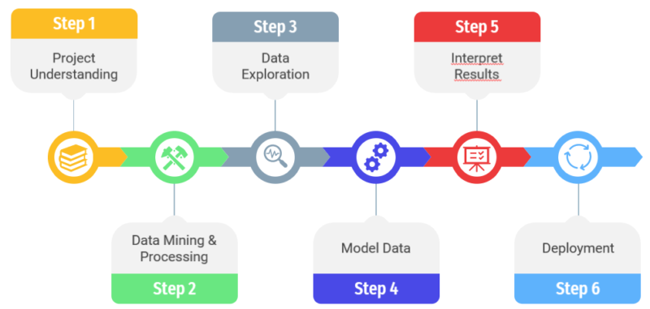
Steps Involved

Slide 5
EDA
Exploratory Data Analysis refers to the critical process of performing initial investigations on data so as to discover patterns, to spot anomalies, to test hypothesis and to check assumptions with the help of summary statistics and graphical representations. It is a good practice to understand the data first and try to gather as many insights from it.
Identifying the most important variables/features in your dataset.
Testing a hypothesis or checking assumptions related to the dataset.
To check the quality of data for further processing and cleaning.
Deliver data-driven insights to business stakeholders.
Verify expected relationships actually exist in the data.
To find unexpected structure or insights in the data.

Slide 6
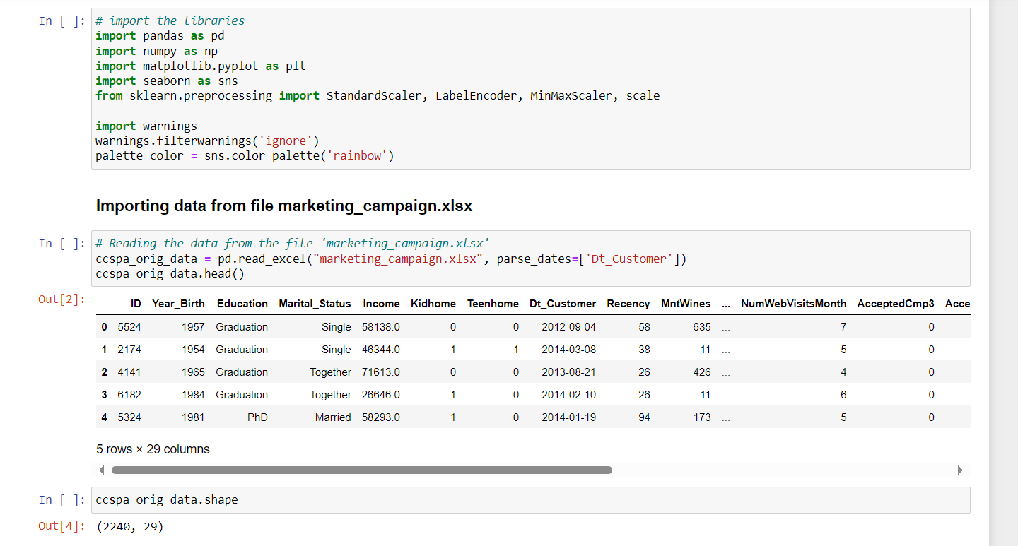
Importing libraries and data set
Libraries imported : Pandas, Numpy, Matplotlib, Seaborn and Sklearn
We have named the dataset as ccspa_orig_data.
Data has 2240 rows and 29 columns.

Slide 7
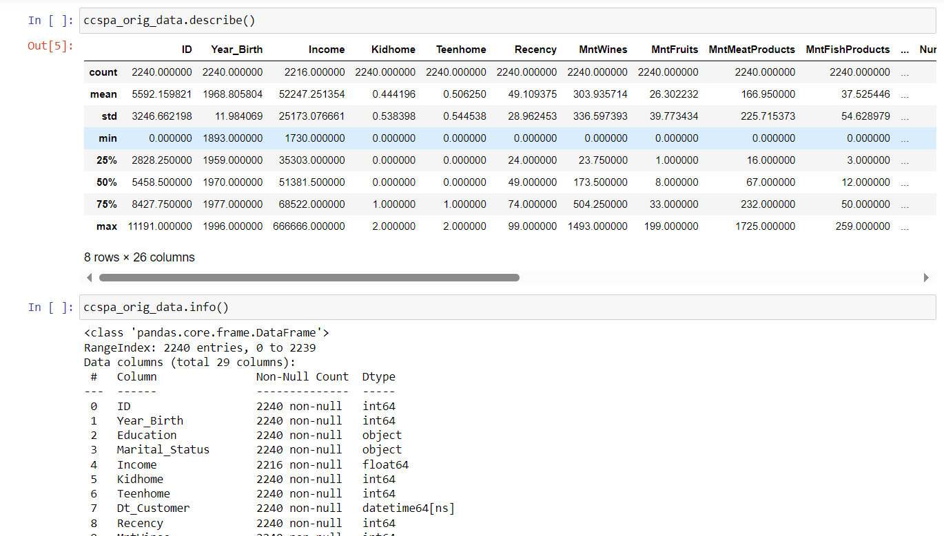
Descriptive analysis of the data
Count, Mean, Standard Deviation, minimum & maximum values and the quantiles of the data are calculated
No null values identified in the dataset

Slide 8
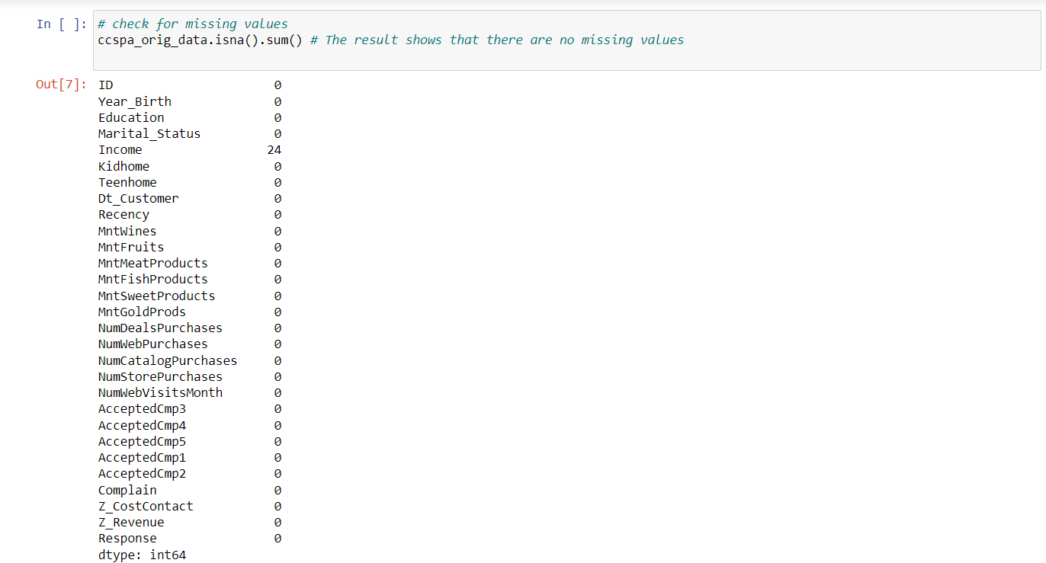
Checking for missing values
The result shows that there are 24 missing values in the income column which has to be dropped from the dataset

Slide 9
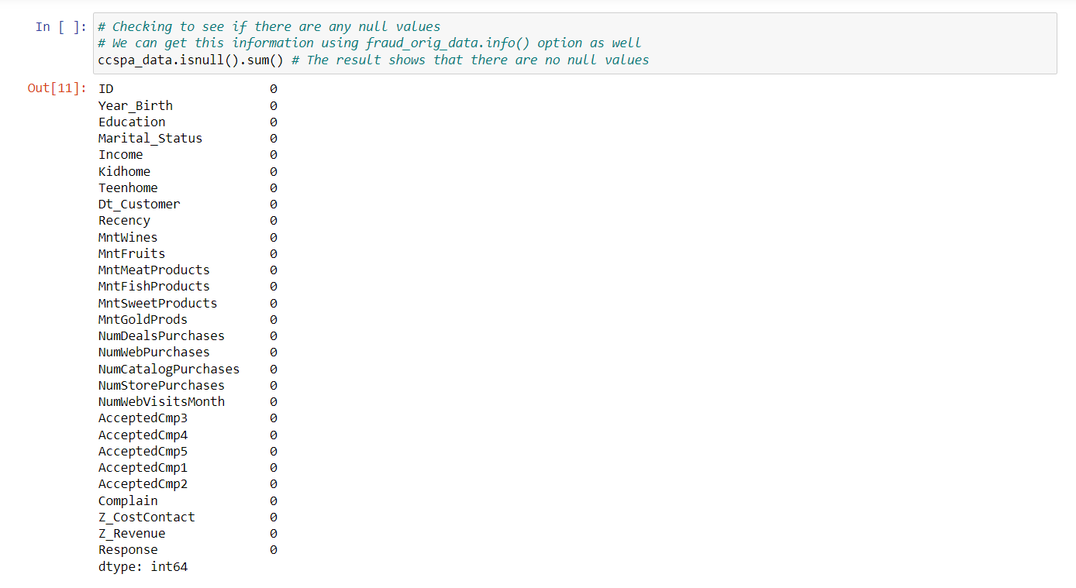
Checking for null values
There are zero null values in the dataset

Slide 10
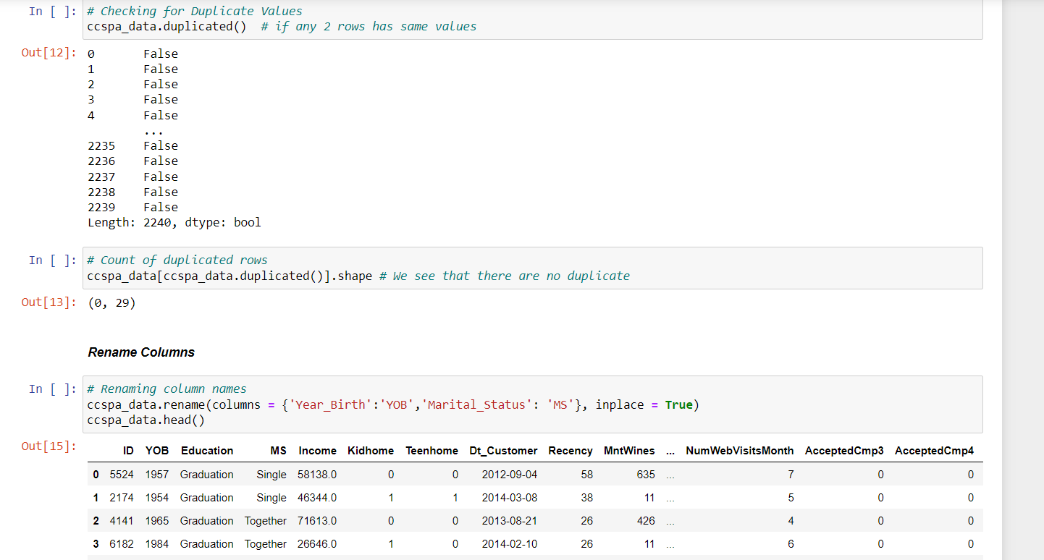
Checking for duplicate values and renaming the columns
There were no duplicated values found in the dataset.
Renaming the columns Year_Birth to YOB and Marital_status to MS

Slide 11
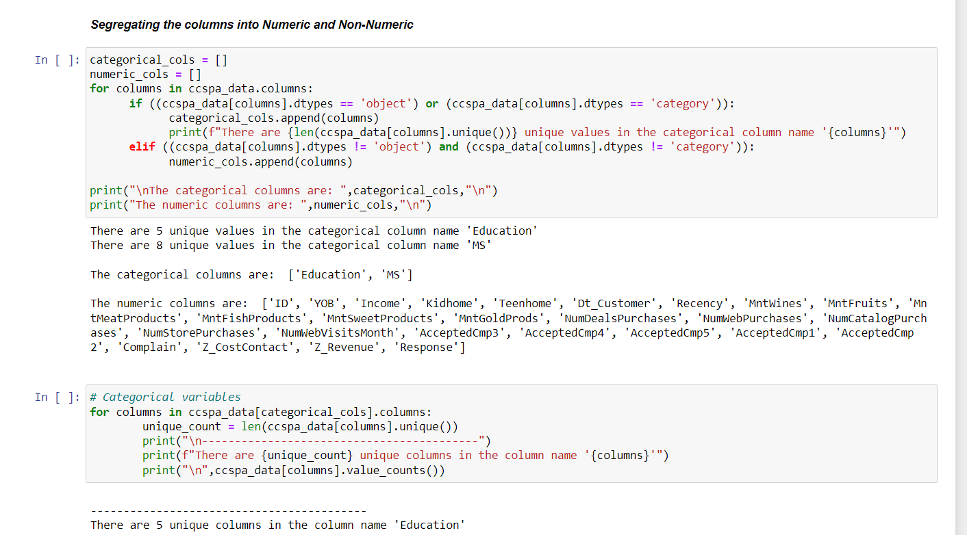
Segregating the data into numeric and non-numeric
Segregating the data into Numeric and categorical data

Slide 12
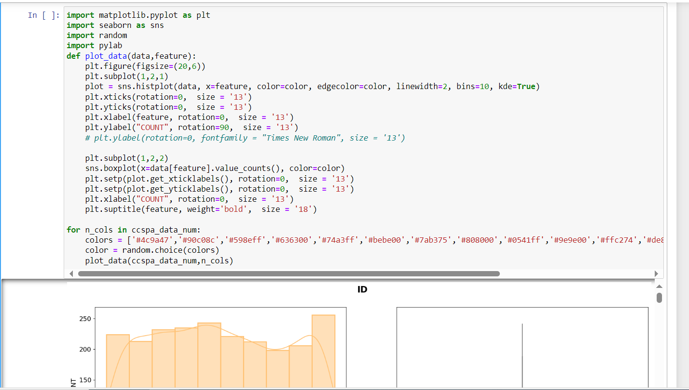
Visualization
Matplotlib, Seaborn, Random and Pylab are used for Visualization
To aid comprehension, Histplots and Boxplots are plotted side by side..

Slide 13
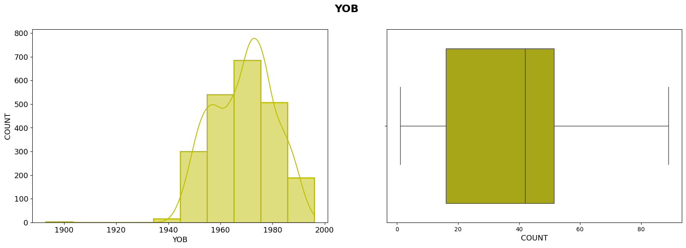
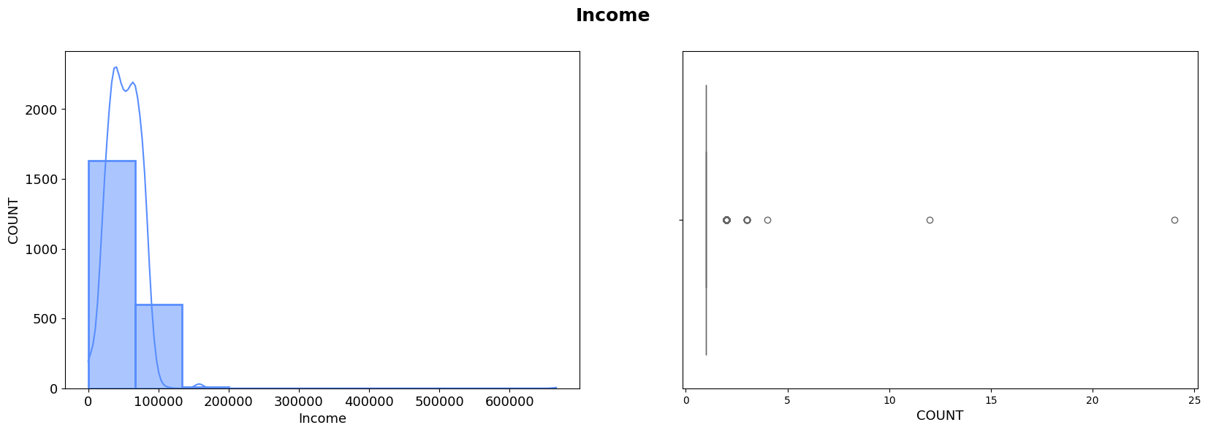
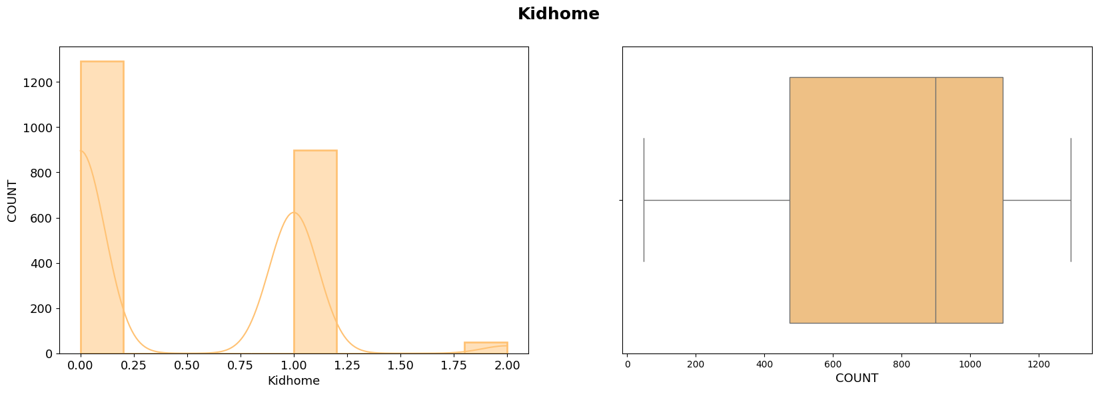
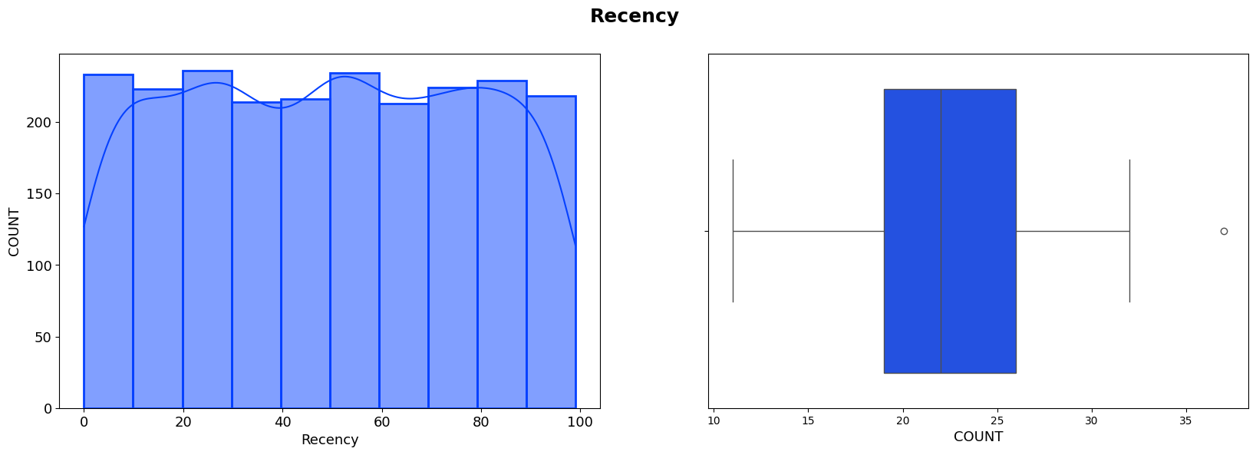
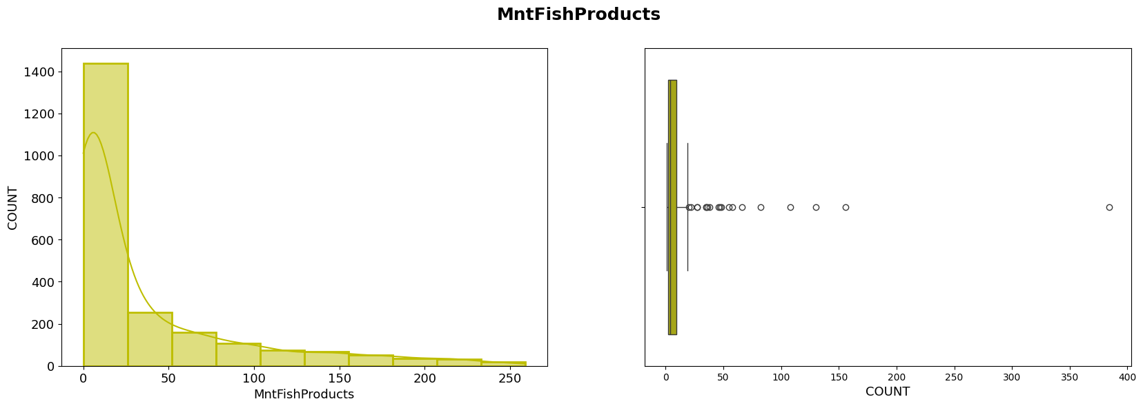
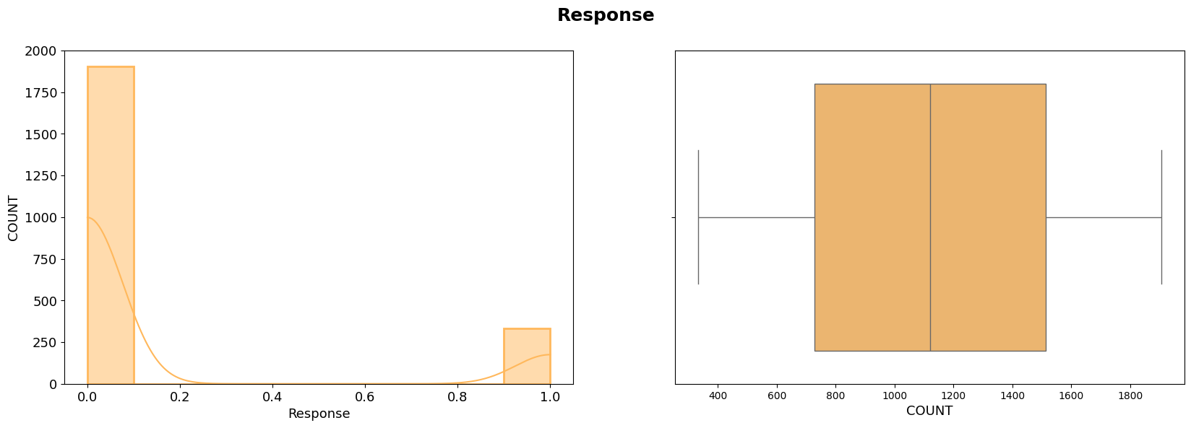
On analyzing the plots we understand that most of the columns are left skewed

Slide 14
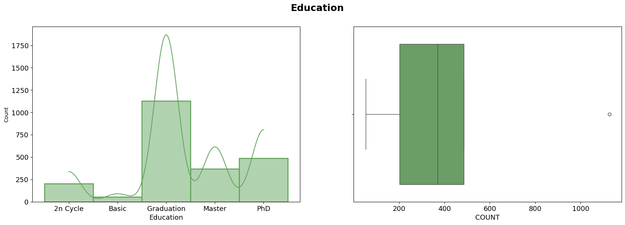
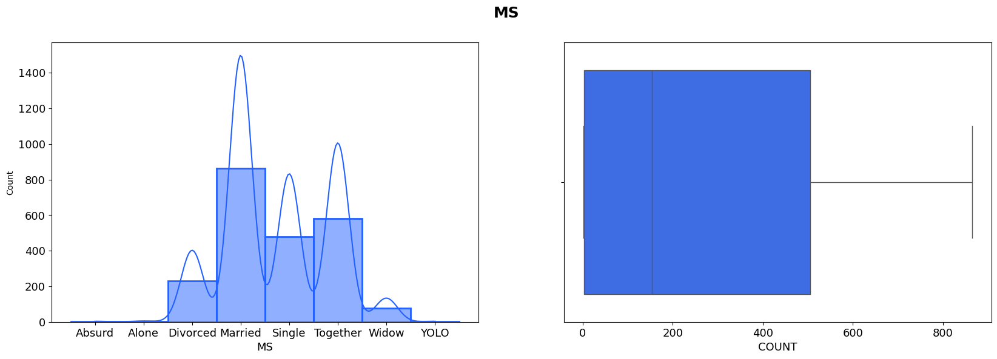
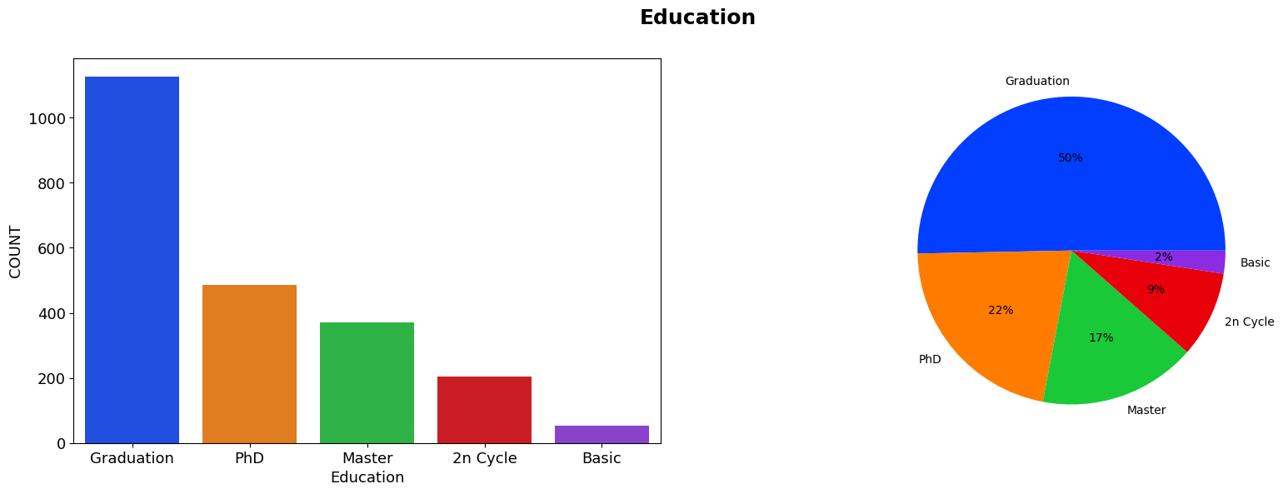
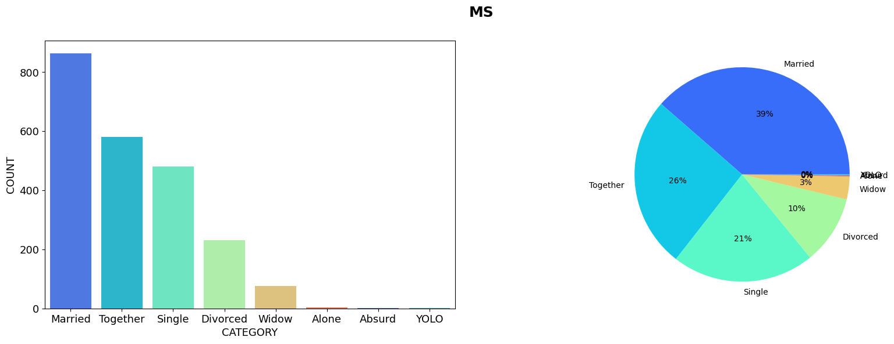
Analyzing the data
On analyzing the data we understand that most of the customer are Graduates and married

Slide 15
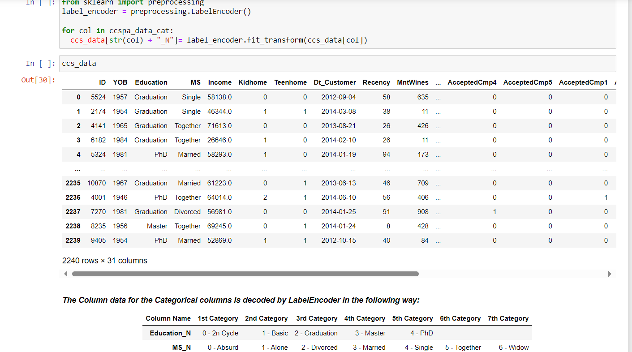
Label Encoding
Categorical columns are decoded by label encoder and categorical data is converted into numerical values.

Slide 16
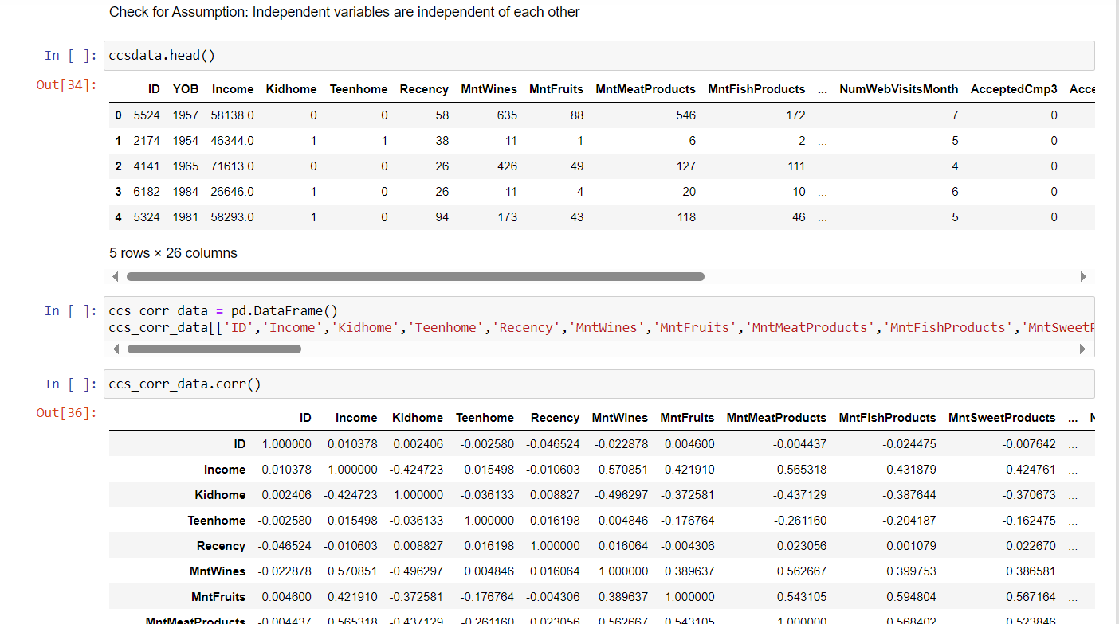
Correlation Matrix
A correlation matrix helps in identifying correlation coefficients between variables. Each cell in the table shows the correlation between two variables.

Slide 17
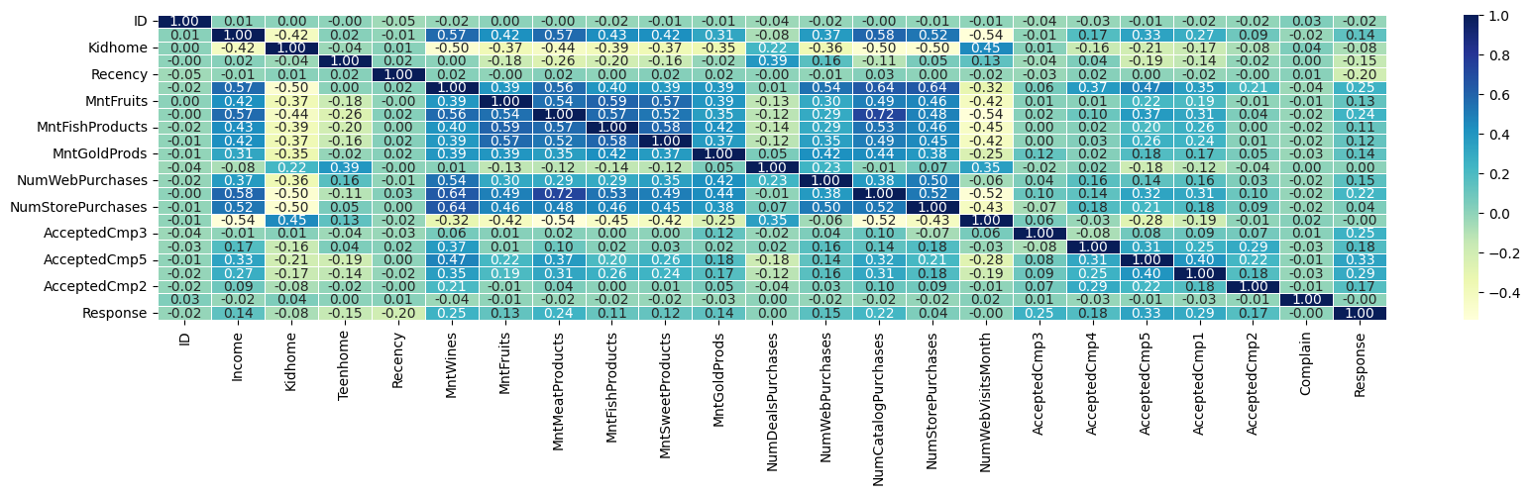
Plotting Heatmap and scatter plot to check the correlation between variables
Based on the plot, we see very little correlation between the individual entities. So the problem of collinearity will not arise.

Slide 18
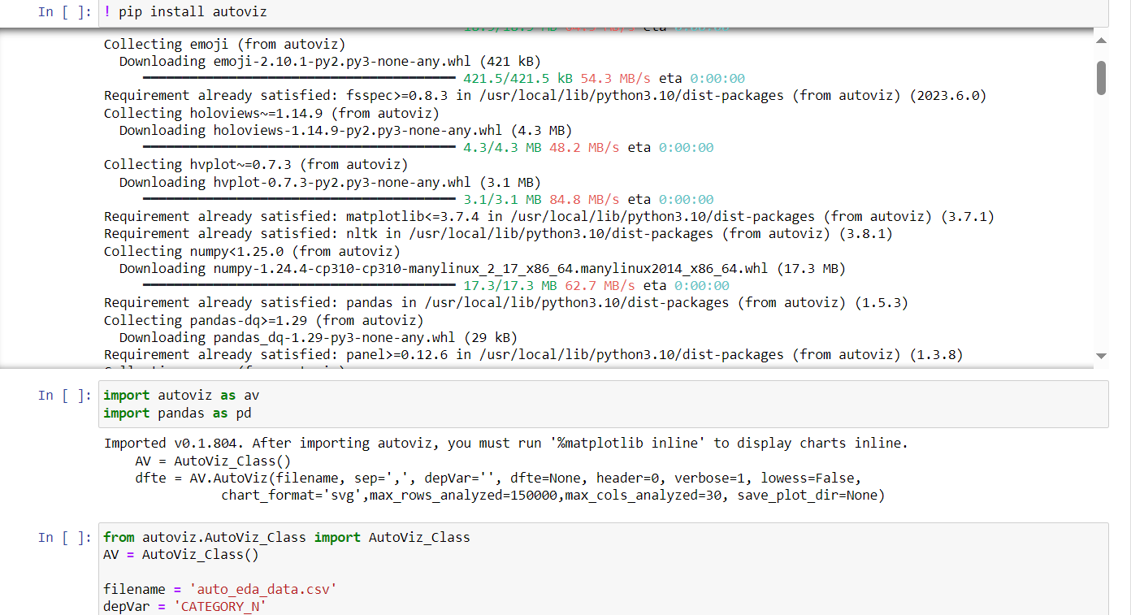
Automated Exploratory Data Analysis (EDA)
Analyzing EDA using Autoviz package

Slide 19
DIMENSIONAL REDUCTION TECHNIQUE
PCA (PRINCIPAL COMPONENT ANALYSIS)
PCA identifies the directions (principal components) in which the data varies the most.
By retaining only the top principal components that capture most of the variance, PCA reduces the dataset's dimensionality.

Slide 20
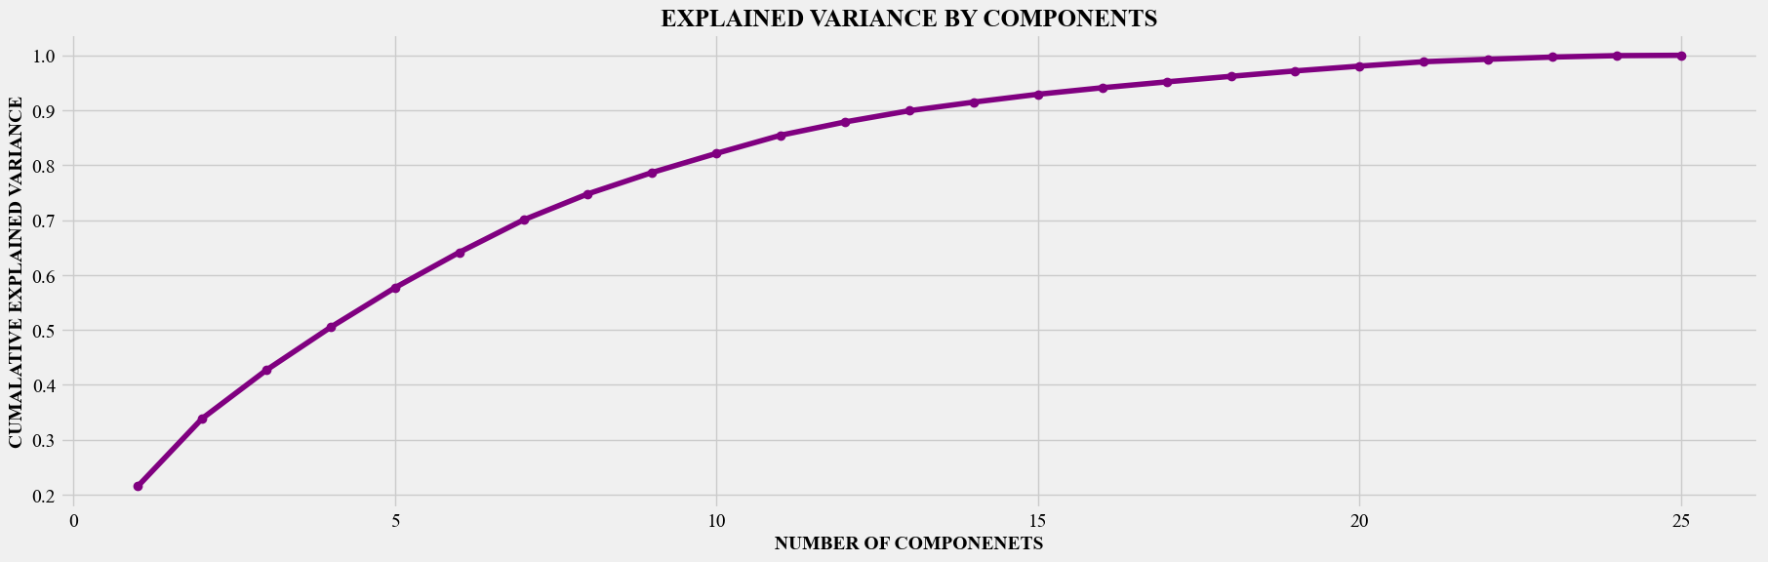
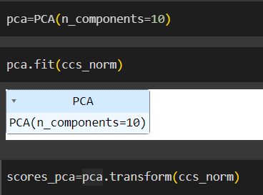
THEN WE FIT THE PCA TO NORMALISED DATA
THIS FIGURE SHOWS EXPLAINED VARIANCE BY COMPONENTS. THE BEST PRACTICE IS TO TAKE 0.8 ABOVE CUMALATIVE EXPLAINED VARIANCE i.e 10. SO THE NUMBER OF COMPONENTS IS 14

Slide 21
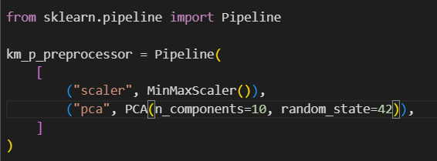
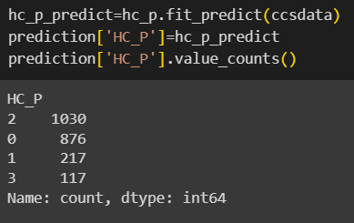
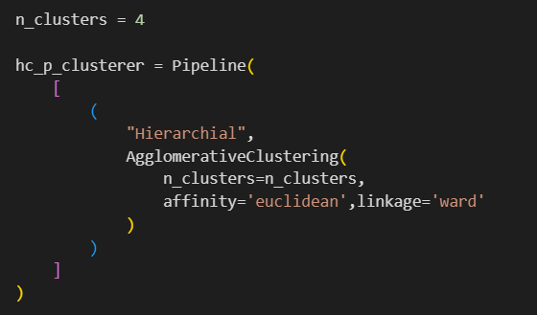
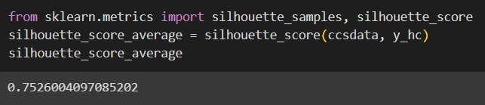
1. HIERACHICAL CLUSTERING USING PIPELINE
A clustering pipeline is a series of interconnected steps or processes designed to perform clustering analysis on a dataset.
FOR PRE-PROCESSOR WE ARE USING MINMAX SCALER AND PCA FOR ALL THE CLUSTERING
3 CLUSTERS WITH THEIR VALUE_COUNTS
SILHOUTTE SCORE IS 75%
WE HAVE USED WARD LINKAGE WITH AFFINITY AS EUCLIDEAN AND 4 CLUSTERS

Slide 22
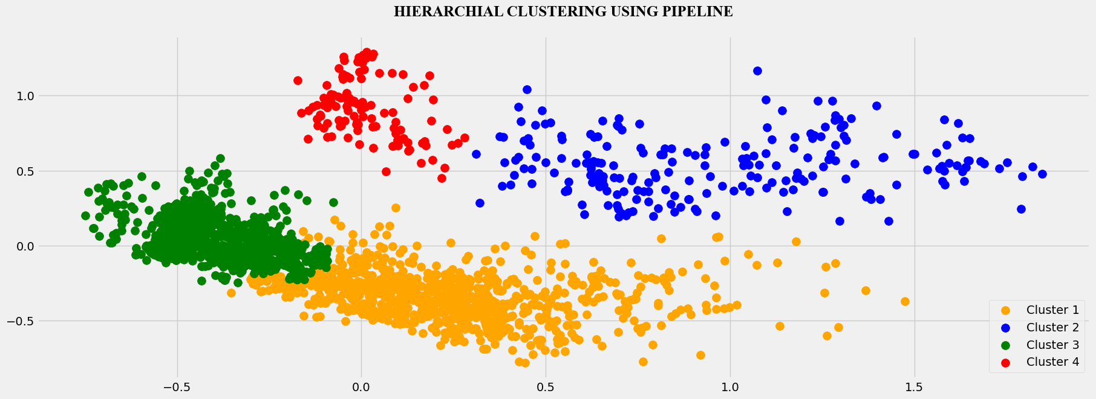
SCATTER PLOT FOR HIERACHICAL CLUSTERING

Slide 23
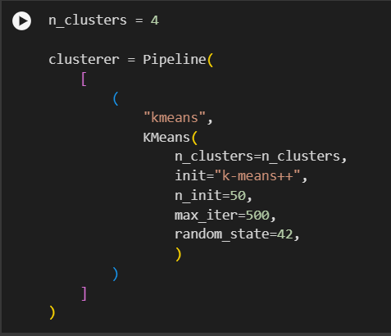
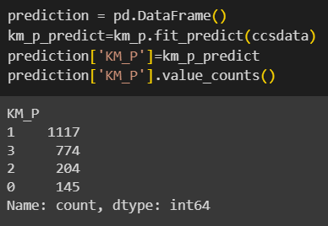
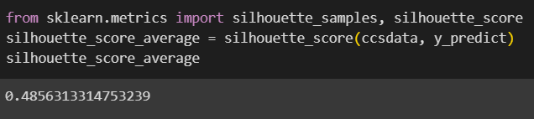
2. KMEANS CLUSTERING USING PIPELINE
4 CLUSTERS WITH THEIR VALUE_COUNTS
WE HAVE USED MAX ITERATION AS 500 AND 4 CLUSTERS
SILHOUTTE SCORE IS 48%

Slide 24
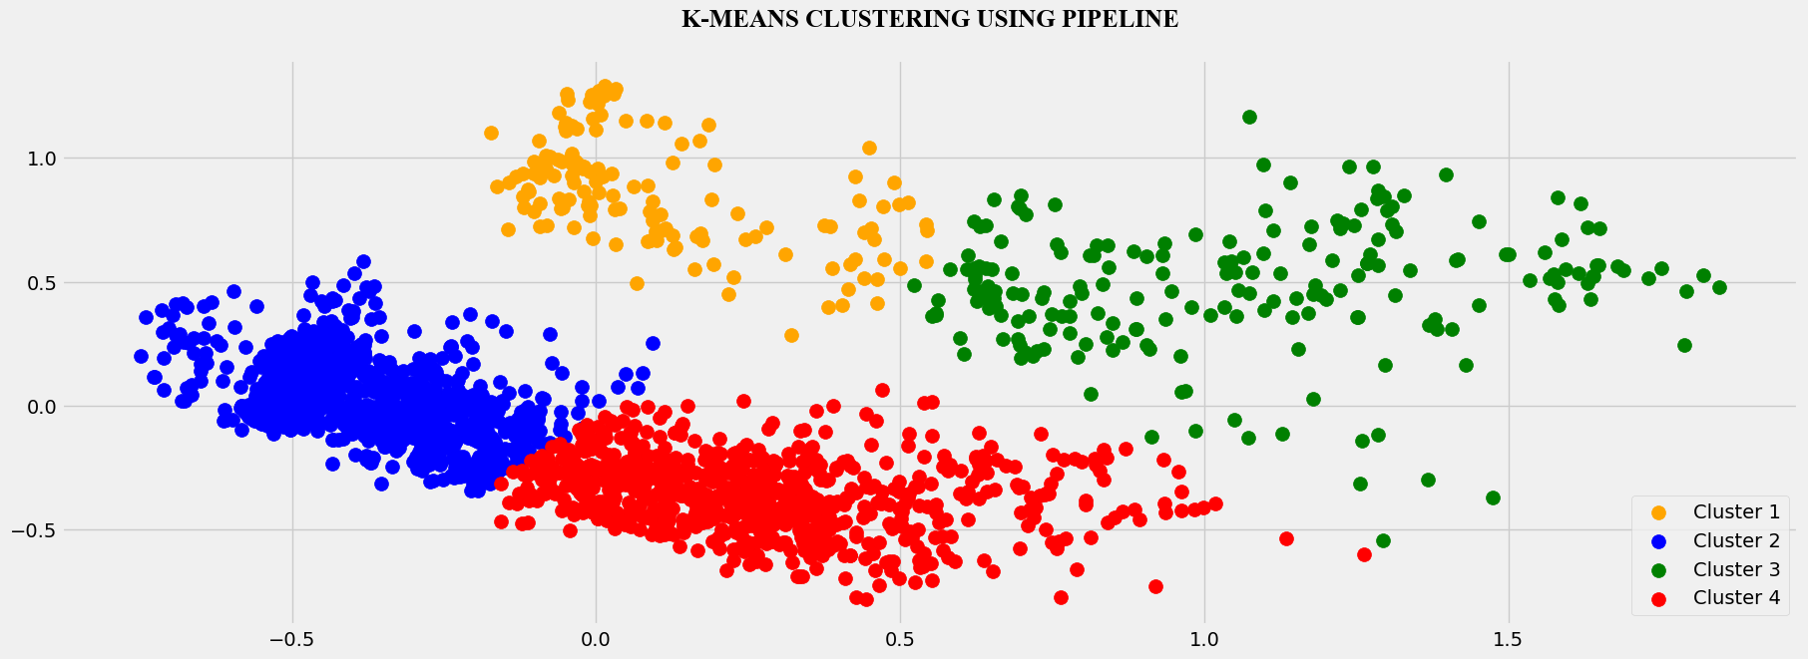
SCATTER PLOT FOR KMEANS CLUSTERING

Slide 25
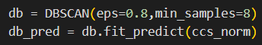
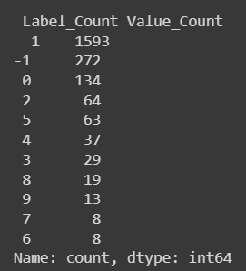
3. DBSCAN CLUSTERING
WE HAVE USED EPSILON DISTANCE AS 0.8
AND MINIMUM SAMPLES AS 8
8 CLUSTERS WITH THEIR VALUE_COUNTS

Slide 26
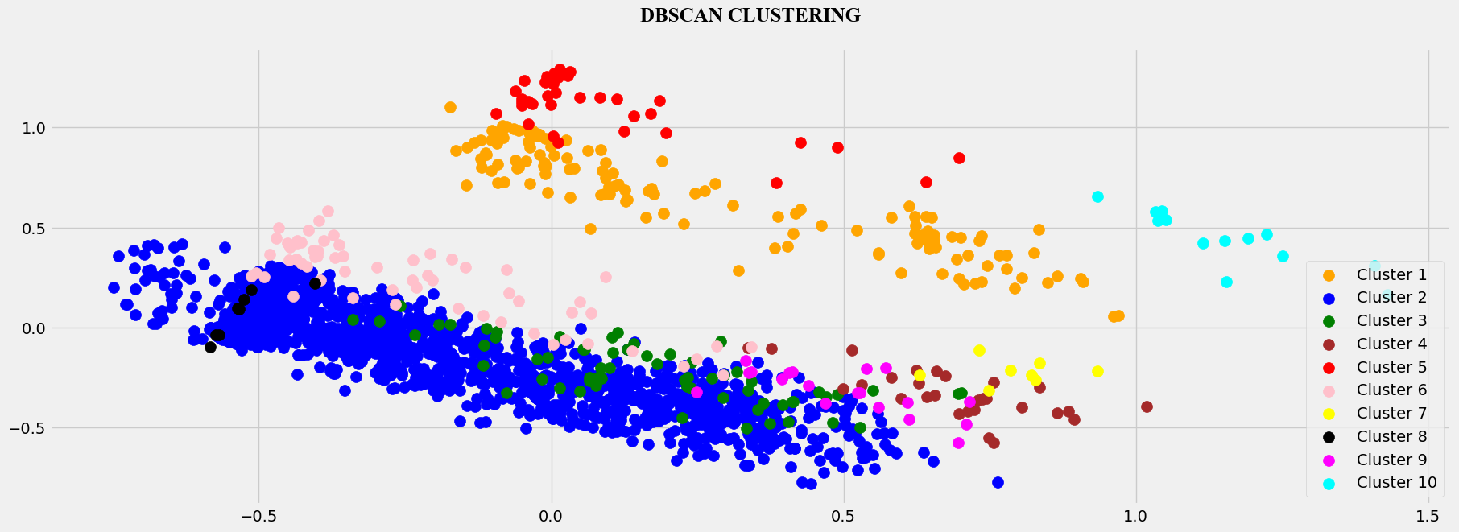
SCATTER PLOT FOR DBSCAN CLUSTERING

Slide 27
Silhouette Score
Silhouette score for KMEANS was 48%
Silhouette score for HIERACHICAL CLUSTERING was 75%
Silhouette score for DBSAN was -14%
Even though the Silhouette score is 48% for Kmeans, we are using it for prediction as the cluster appear in more distinct way

Slide 28
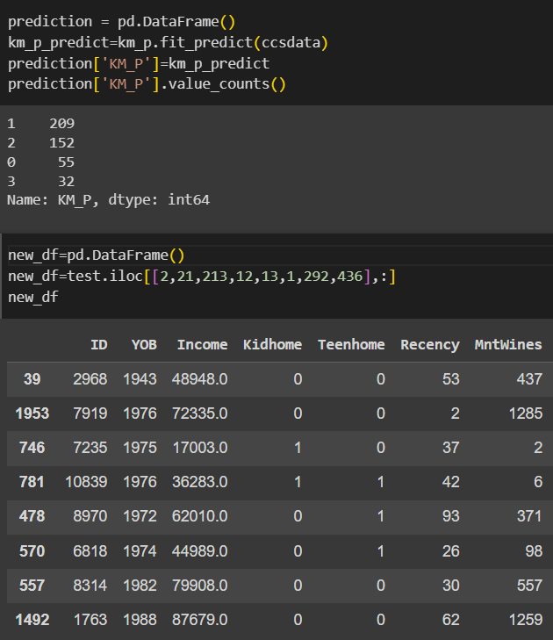
Prediction on KMEANS
We create a prediction data frame and load the predict values of kmeans cluster
Then we found the values counts of each cluster
We created a new data frame (new_df) of 8 random columns

Slide 29
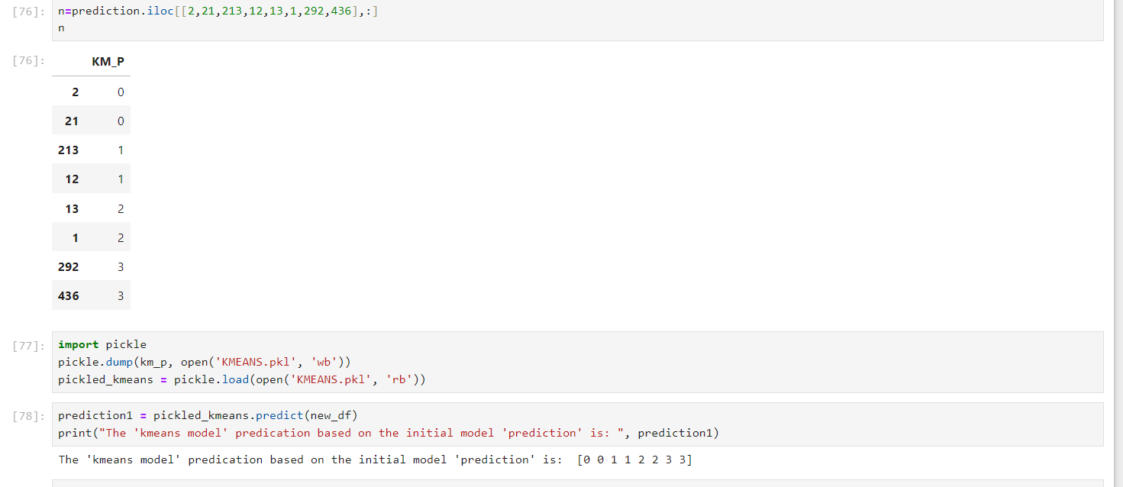
Pickling the data and predicting
Data was picked as pickled kmeans.
To test the accuracy, a random columns of kmeans prediction was chosen to see if it would show the correct clusters in which they were located, and then we found the prediction for pickle kmeans, we found that both the results were matching

Slide 30
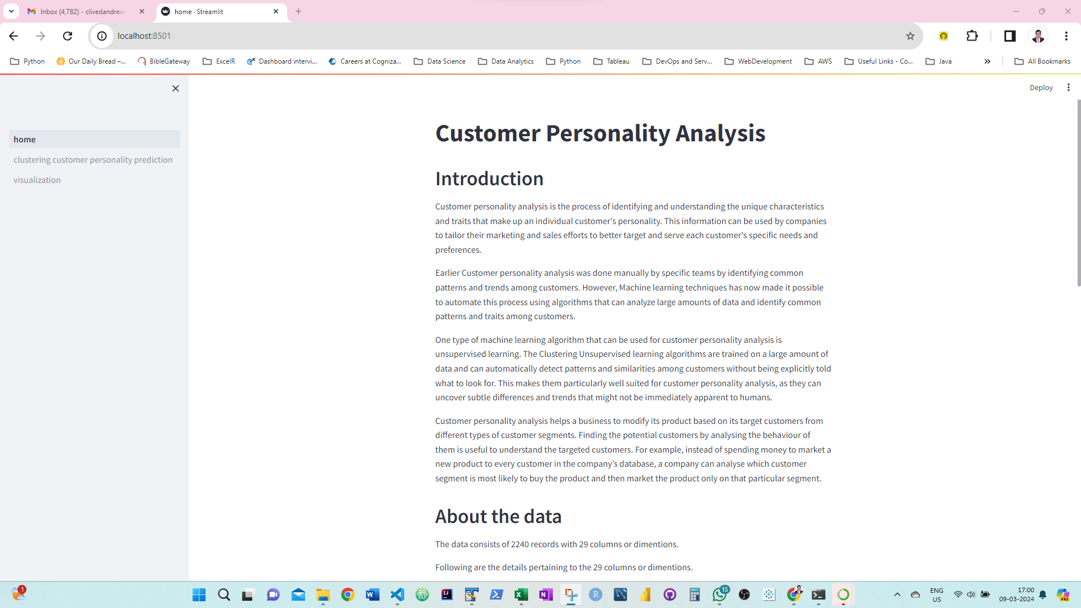
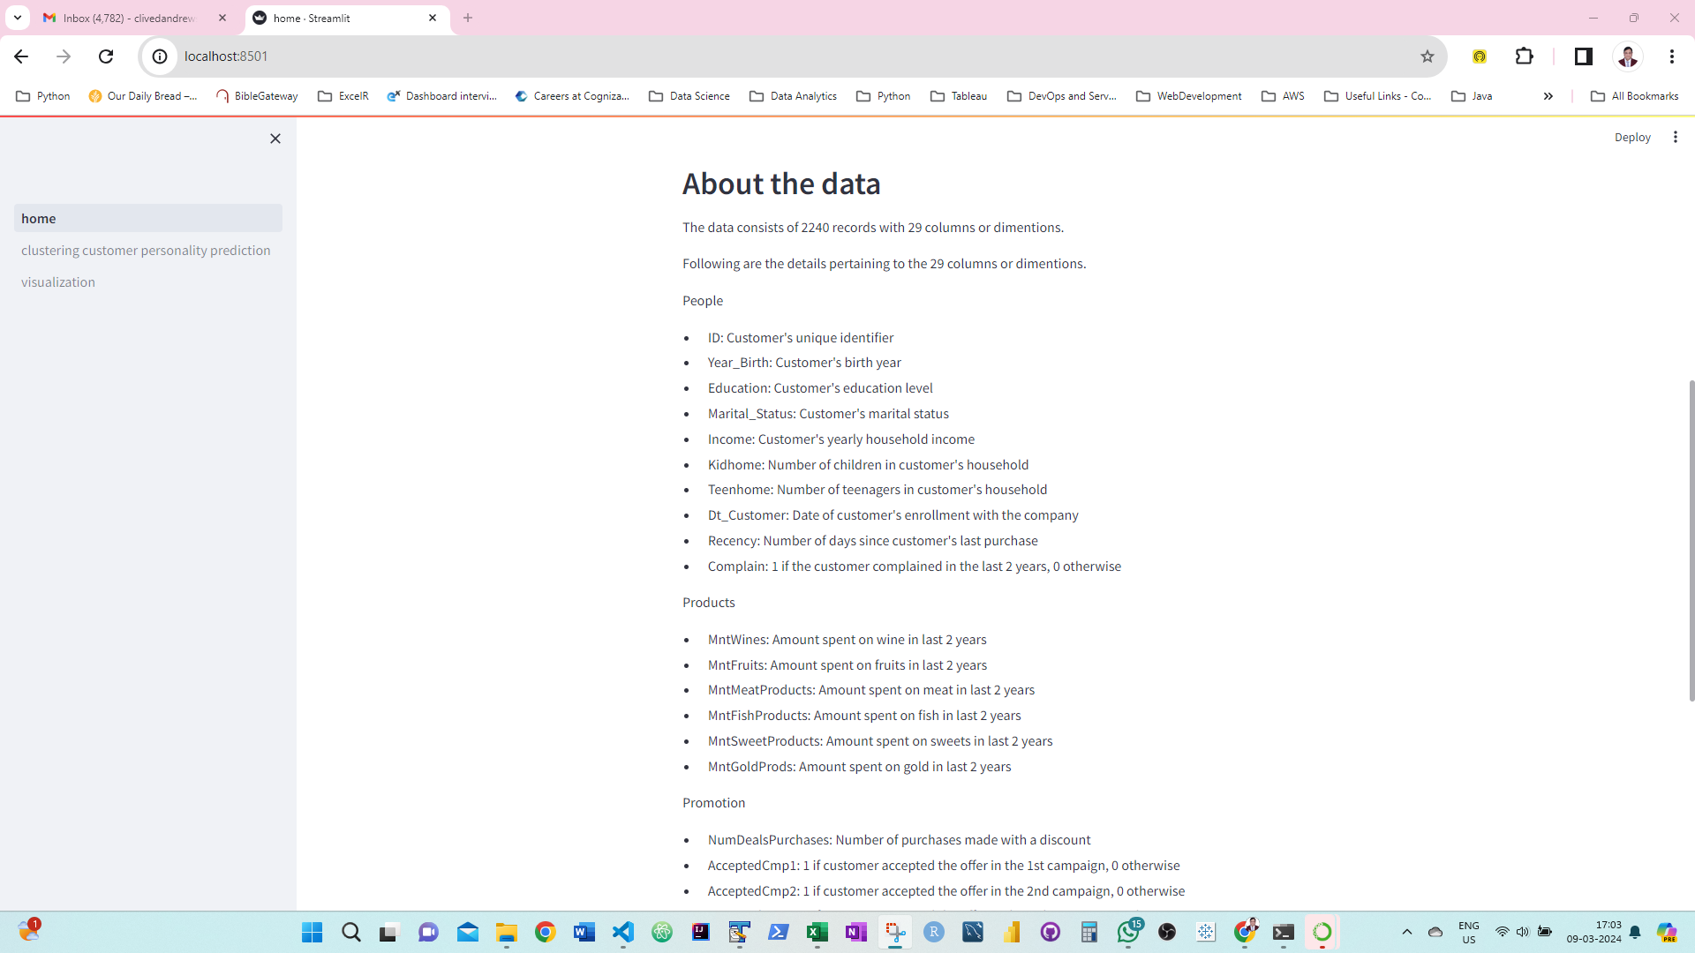
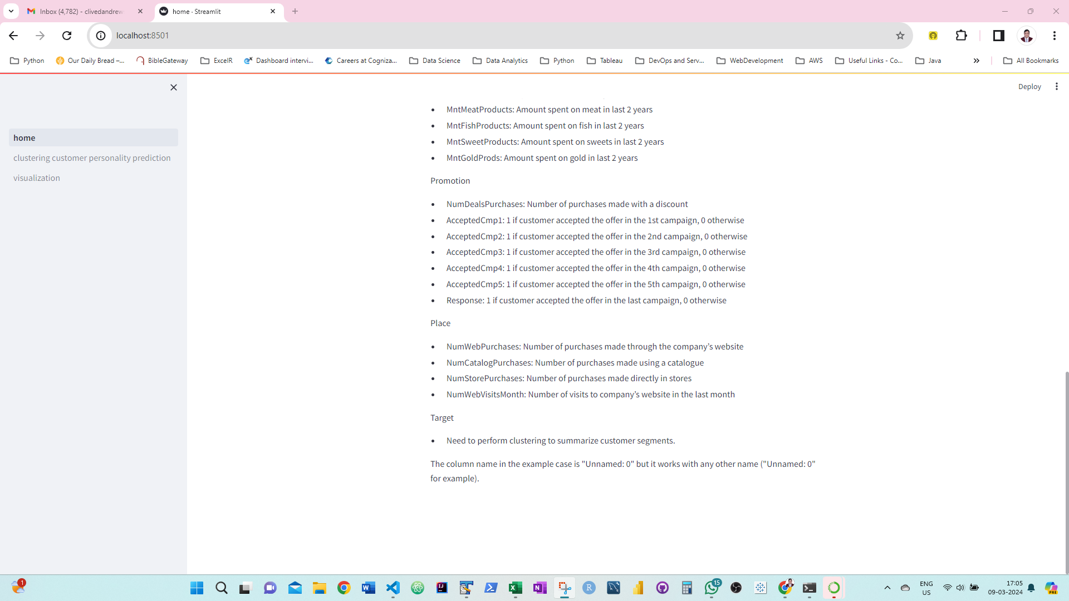
DEPLOYMENT
HOME PAGE

Slide 31
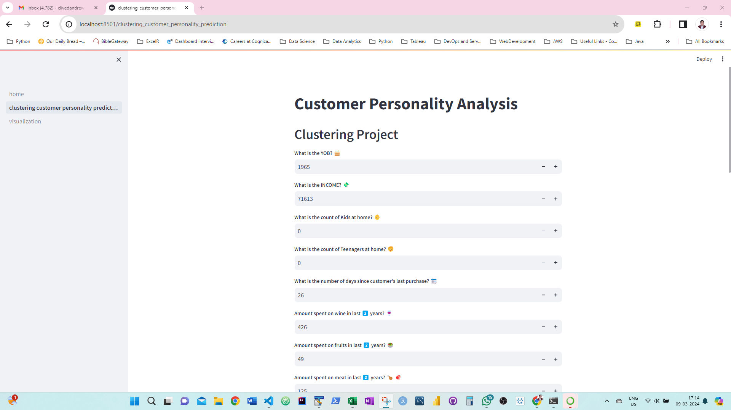
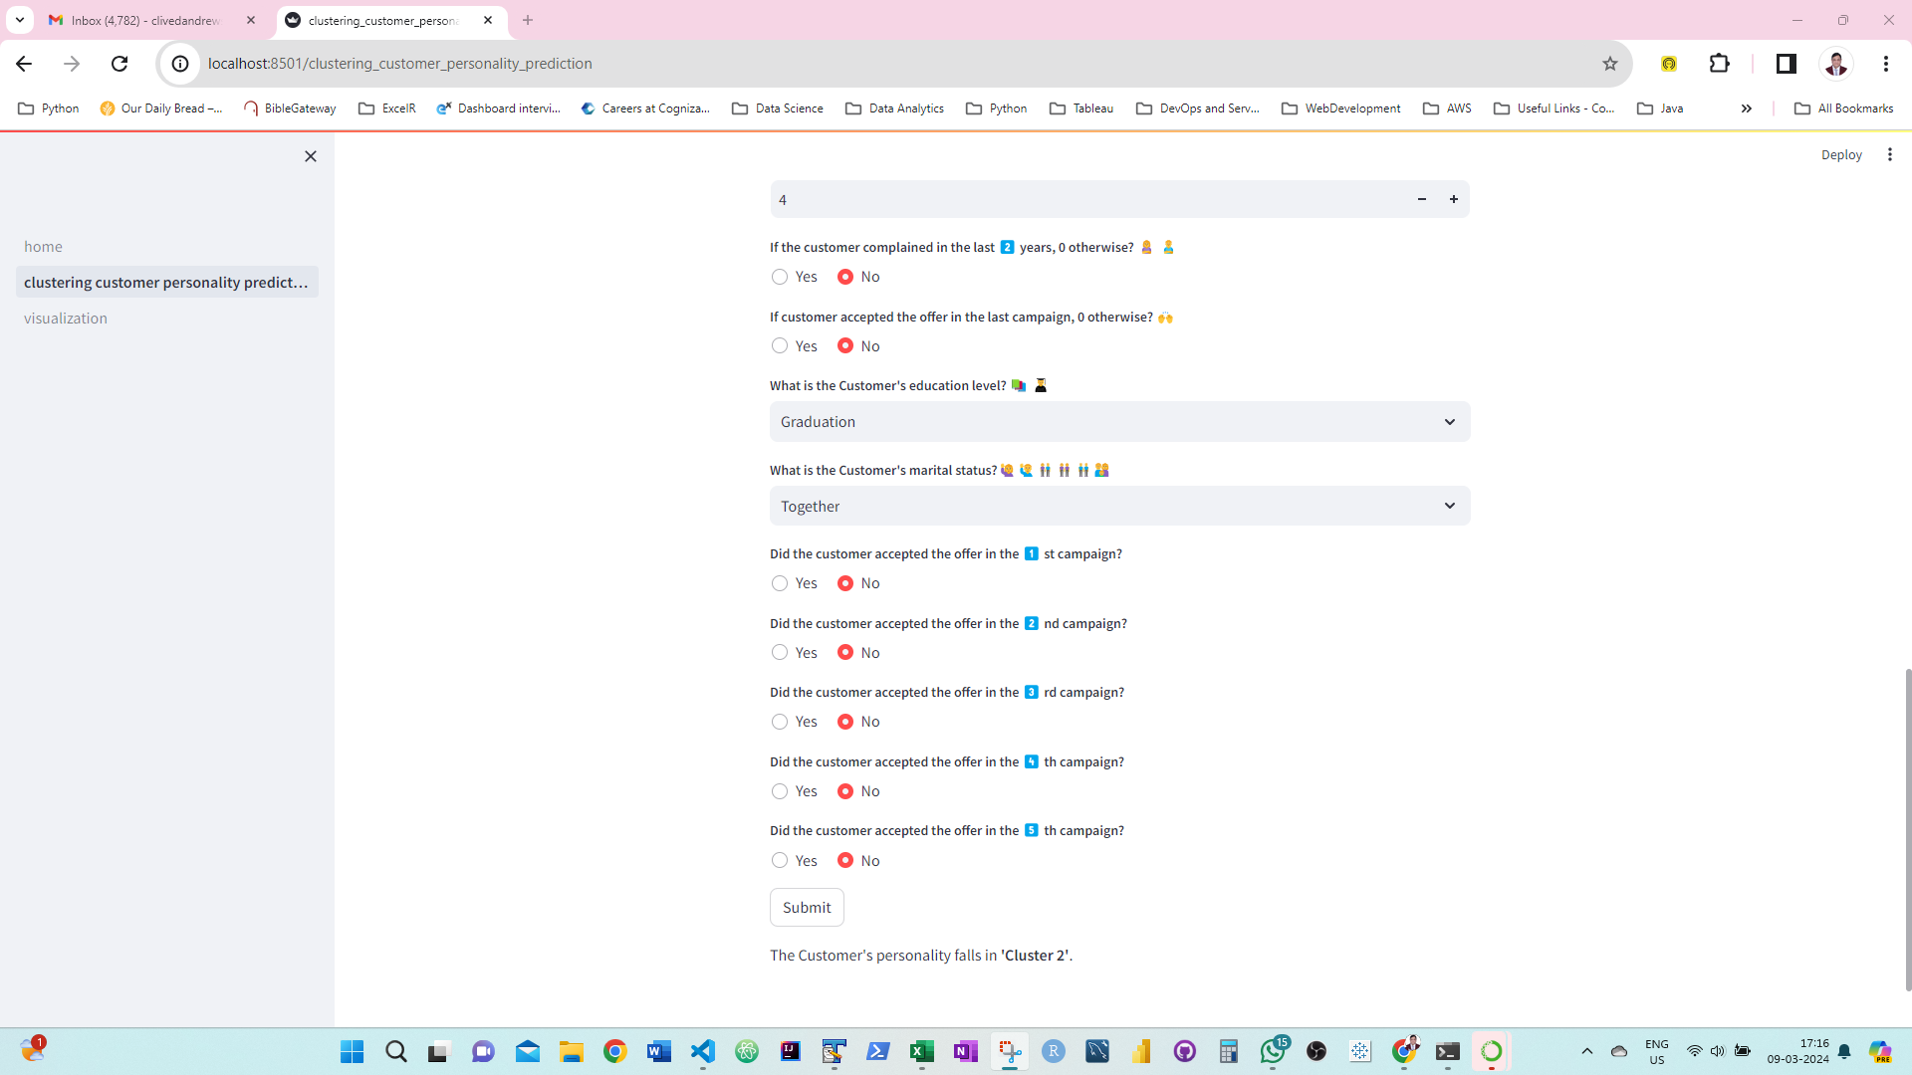
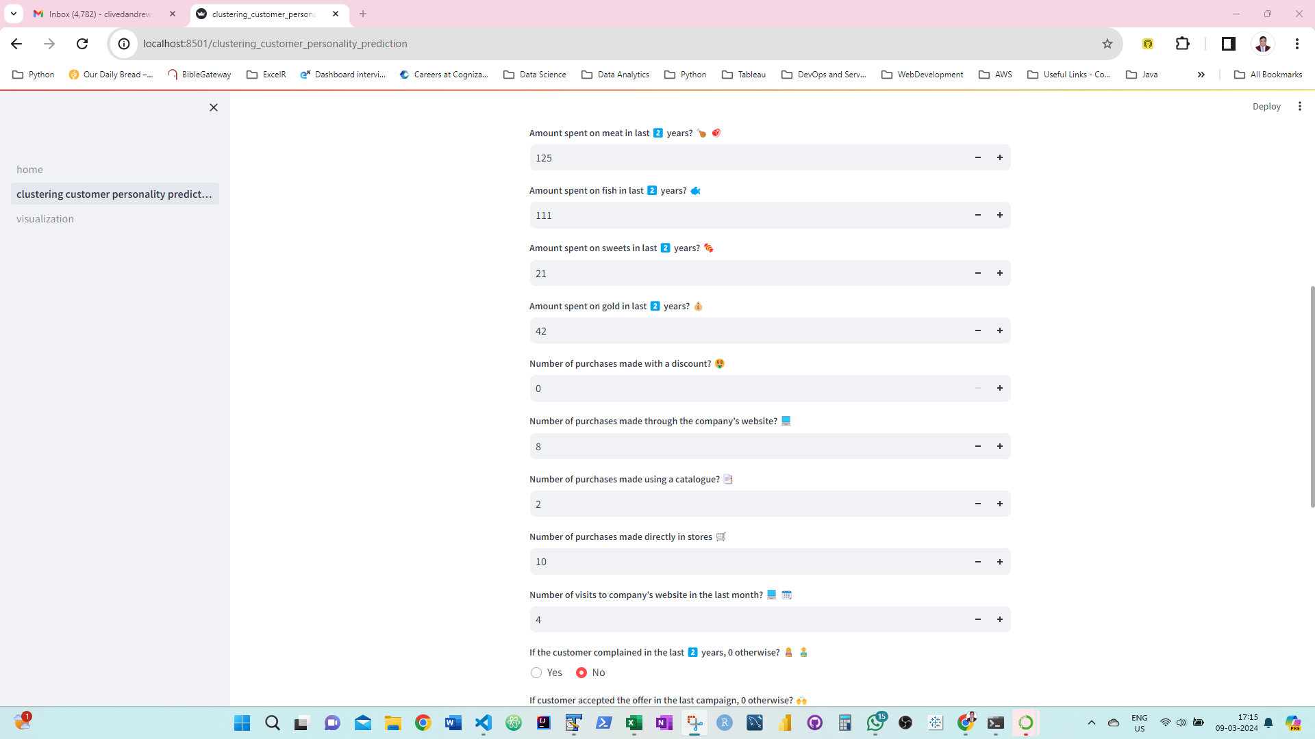
PREDICTION PAGE

Slide 32
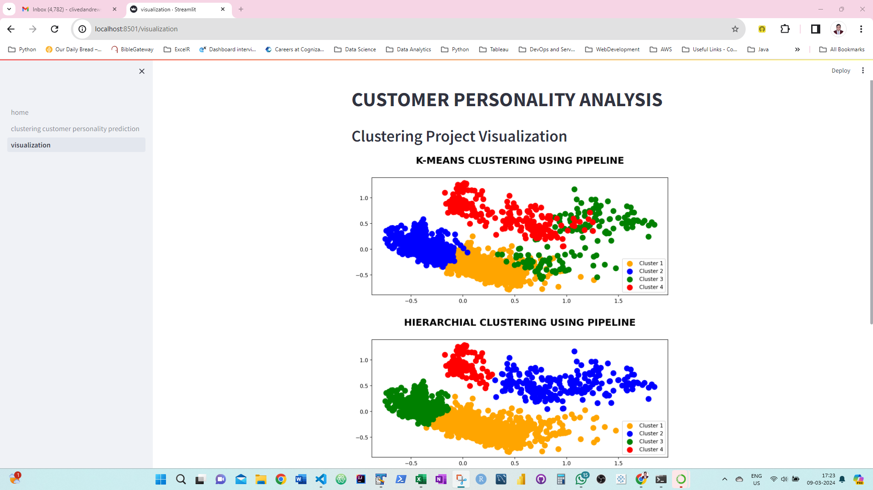
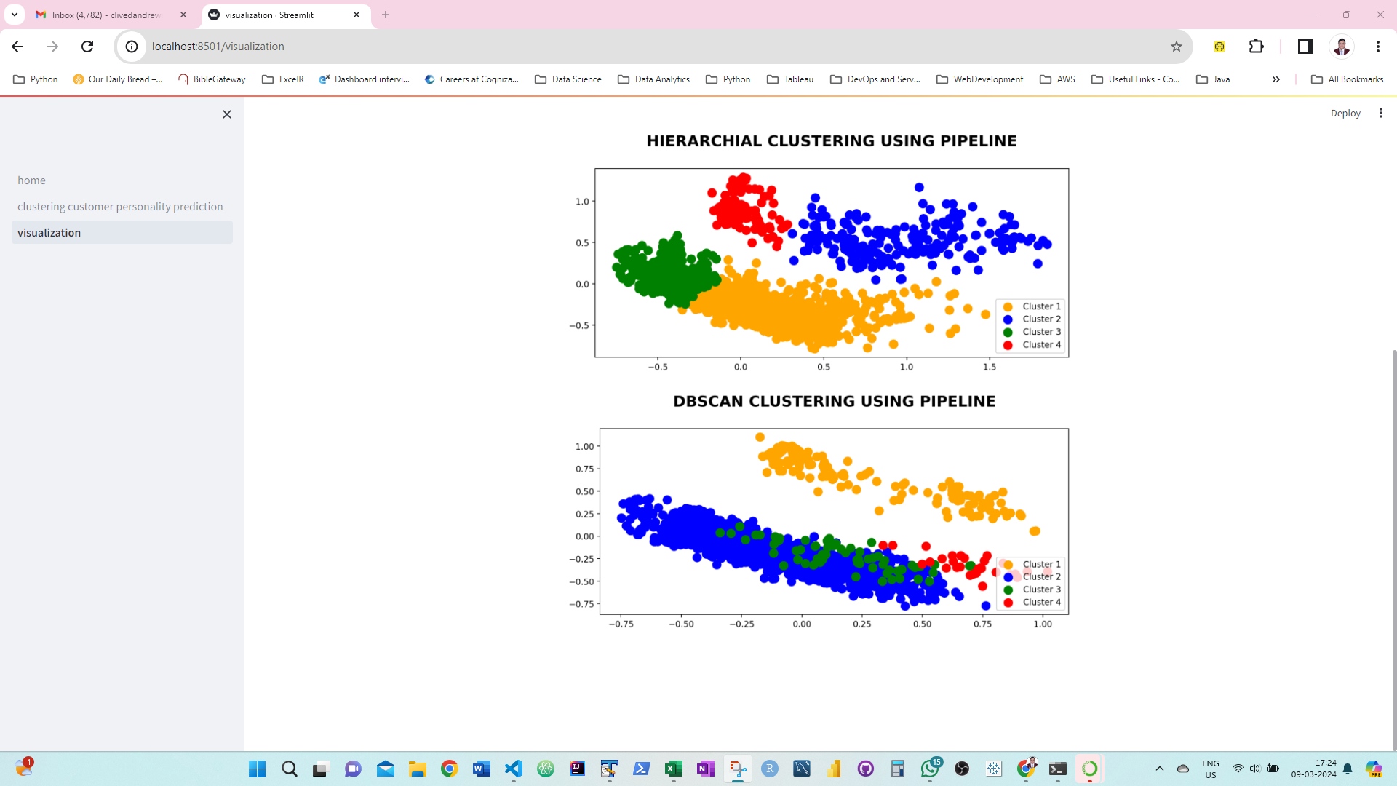
VISUALISATION PAGE

Slide 33
CHALLENGES FACED
For Dbscan the cluster was not distinct enough for visualisation so we had to use different epsilon distance and minimum points
Dbscan through pipeline was not working so we found out that by removing pca the number of cluster would be same as predicted
By splitting the data into numerical and categorical columns it was easier to visualize the data
Using label encoding on education and martial status column it was easier to plot the bar and pie plots

Slide 34
CONCLUSION
Clustering is a valuable tool for organizing complex data and uncovering patterns. While various algorithms offer different approaches, successful implementation depends on careful consideration of factors like feature selection and algorithm choice by comparing the silhouette score of various algorithms.
With its ability to identify relationships and anomalies, clustering facilitates better decision-making across multiple fields.
By using kmeans clustering we were able to identify what products the customers were interested in buying, so that the company would advertise the products to those customers

Slide 35


